Slide 1
Design and Study of a Human-Human Interaction System to Control the Movement of Paralyzed Hand
Presented by
Ankita Giroti
M. Sc. Semester III
Under the Guidance of
Dr. Mrs. A. D. Sakhare
Department of Electronics and Computer Science,
Rashtrasant Tukadoji Maharaj Nagpur University, Nagpur

Slide 2
Contents
Background
Review of Literature
Problem Statement and Definition
Significance of Proposed Work
Objectives of Proposed Work
Orientation of the Proposed Work
Requirements Specification
Planning and Scheduling
Methodology
Experimental Work
References

Slide 3
Background
Arm and hand paralysis can lead to permanent damage if does not treated properly
Traditional methods can be used (like mirror therapy) to regain muscle strength, but are not that effective
A system can be designed to control the moves of the patient with hand paralysis by replicating the therapist actions

Slide 4
Literature Review
Sr. No. | Title | Author | Source | Description
1 | Machine Learning for Detection of Muscular Activity from Surface EMG Signals | Francesco Di Nardo, Antonio Nocera, Alessandro Cucchiarelli, Sandro Fioretti and Christian Morbidoni | Sensors, 1(1), pp. 1-4, 2022 | Used surface EMG to detect muscle contraction. The proposed system predicted onset/offset timing of muscular recruitment of the machine learning based methods.
2 | Design of an Exoskeleton for Hand Rehabilitation | Ankita L. Dharmik, S. K. Atre, S. J. Sharma | IEEE Conference and Interdisciplinary Approach in Technology and Management for Social Innovation (IATMS), 1(1), pp. 1-4, 2022 | An exoskeleton was designed to assist a person with disability using EMG sensor to acquire signals from the muscles and convert into voltage. Microcontroller was programmed to rotate servo motor.
3 | Explainable Machine Learning Techniques to Predict Muscle Injuries in Professional Soccer Players through Biomechanical Analysis | Mailyn Calderon-Diaz, Rony Silvestre Aguirre, Juan P. Vasconez, Roberto Yanez, Matias Roby, Marvin Querales, Rodrigo Salas | Sensors, 24(119), pp. 1-13, 2024 | Paper presented a Hamstring strain injury detection technique using various Machine Learning techniques to find the accurate result.

Slide 5
Literature Review
Sr. No. | Title | Author | Source | Description
4 | I Want to Control Your Move: Human-Human Interface (HHI) Neuromuscular Electrical Stimulator (NMES) | Ching Yee YONG and Terence Tien Lok SIA | Conference of Electronics, Communication and Networks (CECNet), 1(1), pp. 724-730, 2022 | The system implemented Neuromuscular Electrical Stimulator (NMES) integrated with Human-Human Interaction (HHI) for hand rehabilitation using IoT.
5 | A Systematic Review of EMG Applications for the Characterization of Forearm and Hand Muscle Activity during Activities of Daily Living: Results, Challenges, and Open Issues | Nestor J. Jarque-Bou, Joaquin L. Sanche-Bau, Margarita Vergara | Sensors, 24(119), pp. 1-13, 2024 | The paper had studied EMG to characterized muscle activity of the hand. It focuses on human hand behavior , improve rehabilitation, control prothesis, etc.

Slide 6
Literature Review
Sr. No. | Title | Author | Source | Description
6 | A New Wrist-forearm Rehabilitation Protocol Integrating Human Biomechanics and SVM-Based Machine Learning for Muscle Fatigue Estimation | Yassine Bouteraa, Ismail Ben Abdallah, Khalil Boukthir | Bioengineering, 10(219), pp. 1-22, 2023 | A remote rehabilitation system that integrates a IoT based connected robot for wrist and forearm rehabilitation using Support Vector Machine (SVM) to predict muscle strain from the feature extracted from the EMG signals of the patient.
7 | IoT Based Cost Efficient Muscle Stimulator for Biomedical Application | Md. Latifur Rahman, Md. Jahin Alam, Nayeed Rashid, Lamiya Hassan Tithy, Alfaj Uddin Ahmed, and M Tarik Arafat | 2020 IEEE Region 10 Symposium (TENSYMP), 1(1), pp. 1-5, 2020 | Design a low-cost muscle stimulator integrated with IoT and a feedback system to receive voltages which was send to the IoT device to determine muscle strength.
8 | Towards AI-controlled FES-restoration of arm movements: Controlling for progressive muscular fatigue with Gaussian state-space models | Nat Wannawas and Aldo Faisal | 11th International IEEE Conference on Neural Engineering (NER), 1(1), pp. 1-4, 2023 | Used Reinforcement Learning to observe muscle strength. The Reinforcement Learning – Gaussain State Space Model (RL-GSSM) was trained to control arm movements through muscle stimulator.

Slide 7
Literature Review
Sr. No. | Title | Author | Source | Description
9 | Posture Guardian With Smart Muscle Strain Detection And Correction Using TINYML | Dr. G. Sophia Reena | Journal of Propulsion Technology, 44(4), pp. 5187-5194, 2023 | TinyML was used to detect and correct improper posture using wearable EMG and Flex sensors. The data fed to the Arduino UNO for signal processing.
10 | Development of Wireless Microcontroller Based Functional Electronic Stimulation Device for Drop Foot Correction | DERVİŞ PAŞA | Near East University, Nicosia, pp. 1-87, 2014 | A stimulator was developed for a person with drop foot problem using Force Sensitive Resistor (FSR), programmable microcontroller, transmitter, receiver, and electrodes.
11 | Soft Exoskeleton Glove for Hand Assistance Based on Human-Machine Interaction and Machine Learning | Xiaoshi Chen, Li Gong, Lirong Zheng, and Zhuo Zou | IEEE International Conference on Human-Machine Systems (ICHMS), Rome, Italy, 1(1), 2020 | Developed a human-machine interaction system based on the concept of mirror therapy. Surface EMG were used to collect muscle signals by training a ML model. Flex and pressure sensors were used to process the EMG signals. SVM, k-NN, and subspace k-NN were used for pattern recognition.

Slide 8
Literature Review
Sr. No. | Title | Author | Source | Description
12 | A Wearable Hand Rehabilitation System with Soft Glove | Xiaoshi Chen, Li Gong, Liang Wei, Shih-Ching Yeh, and Li Da Xu | IEEE Transactions on Industrial Information, 17(2), pp. 943-952, 2020 | A tendon-driven motor glove was designed using DC motor controlled by STM32F103 microcontroller. Wi-Fi sensors were implemented on both sides to send and receive EMG signals.
13 | Flexo-glove: A 3D Printed Soft Exoskeleton Robotic Glove for Impaired Hand Rehabilitation and Assistance | Alireza Mohammadi, Jim Lavranos, Peter Choong, and Denny Oetomo | 40th Annual International Conference of the IEEE Engineering in Medicine and Biology Society (EMBC), Honolulu, USA, pp. 2120-2123, 2018 | Designed the portable tendon-driven soft exoskeleton glove for hand rehabilitation and assistance using thermoplastic polyurethane. DC motor were implemented on each finger controlled by ATmega2500 microcontroller.

Slide 9
Literature Review
Sr. No. | Title | Author | Source | Description
14 | Wearable Hand-Rehabilitation System with Soft Gloves for Patient with Face Paralysis and Disability | Waqas Ahmed, Muhammad Kashif Sattar, Wajeeha Shahnawaz, Umair Saeed, Shahbaz Mehmood Khan, and Neha Amon Khan | Engineering Proceedings, 12(56), pp. 1-5, 2021 | Designed a robotic hand controlled by the soft glove placed on the healthy hand. Feature extraction was used to recognize different gestures which was send to the microcontroller. Servo motors was used to perform different hand movements implemented on robotic hand.
15 | Design and Control of a Tendon-Driven Robotic Finger Based on Grasping Task Analysis | Xuanyi Zhou, Hoa Fu, Baoqing Shentu, Weidong Wang, Shibo Cai, and Guanjan Bao | Biomimetics, 9(370), pp. 1-17, 2024 | The tendon-driven robotic finger was developed, controlled by soft glove worn on a human hand to collect data from the hand. Servo motors were implemented on the base of the robotic finger to drive the motion of the tendons.

Slide 10
Problem Statement and Definition
The loss of hand function can significantly hinder daily activities and have a devastating emotional impact. The proposed system aims to assist in regaining hand functionality by facilitating fine-motor activities and mimic the movements of the operator's unaffected hand.

Slide 11
Significance of Proposed Work
The developed system will be able to:
Help individuals with hand paralysis to regain motor functionality
Provide accurate and effective rehabilitation exercises
Increase independence in daily activity

Slide 12
Objectives of the Proposed Work
To design a rehabilitation system for an individual with hand paralysis to regain functionality of their hand
To design a system that senses electromyography (EMG) signals of the hands of the therapist
To train a machine learning model to recognize hand movements
To mimic the hand movement of the therapist
To increase flexibility of the patient’s hand

Slide 13
Orientation of the Proposed Work
The proposed system will assist individual with hand paralysis to recover their hand functionality
The system consist of two phases:
Data collection phase consist of EMG sensor used to collect the data from non-affected hand
Actuation phase consist of servo motor to drive paralyzed hand movements
ESP NOW protocol is implemented to receive the EMG signals from the non-affected hand to drive the servo motor

Slide 14
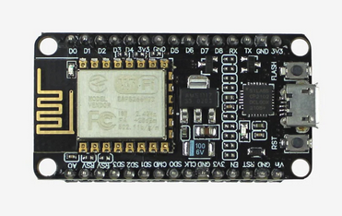
Requirement Specification
Hardware Required
NodeMCU ESP8266
32-bit microcontroller with built-in Wi-Fi
It has 17 GPIO (General Purpose Input/Output) pins
Flash Memory: 4MB
Analog input pin: 1
PWM signal pins: 5
Micro USB connector

Slide 15
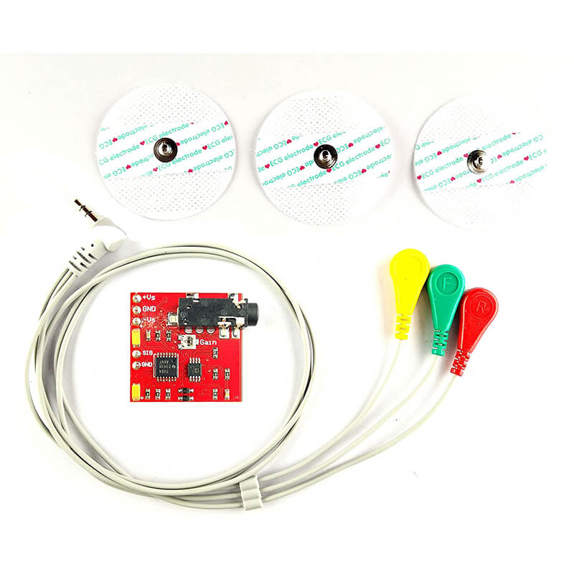
EMG Sensor
Enables the translation of these electrical signals into numerical values
Specially designed for microcontroller
Needs dual power supply for +9V & -9V
Used in Human-Computer interactions, Robotics, and Biomedical devices

Slide 16
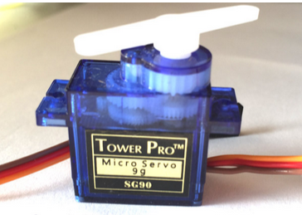
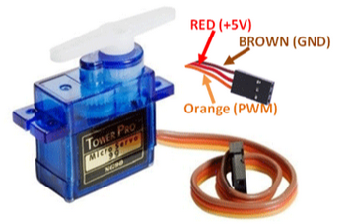
Servo Motor
Used to control the linear motion of the object
It consist of 3 wires:
Brown: Ground wire
Red: Connected to +5V
Orange: PWM signal connected to the Arduino
Rotation: 0º to 180º

Slide 17
Platform Required
Arduino IDE: Arduino IDE is a cross-platform application that allows users to write, compile, debug, and upload code to Arduino boards. It also includes a serial monitor for communication with Arduino boards.
PyCharm IDE: PyCharm is a cross-platform integrated development environment (IDE) designed specifically for Python programming.

Slide 18
Libraries Required
NumPy: Numerical Python is a Python library that adds support for large, multi-dimensional arrays and matrices
Pandas: It is a Python library used to work with datasets for analyzing, cleaning, exploring, and manipulating data
Scikit-learn: It is a machine learning library, supports various algorithms like SVM, Decision tree, and Random forest
Keras: It is a high-level API for TensorFlow and can be used to deploy models on microcontrollers using TensorFlow Lite

Slide 19
Planning and Scheduling
Understanding the problem domain and the difficulties people facing with hand paralysis
Gathering information related to the specified problem
Collection of the required hardware components and software applications are specified in the requirement specification
Analyzing the feasibility of the project
Study of the suitable Machine Learning model that can be deployed on the system

Slide 20
Designing the proposed system and verifying whether it is accepting inputs
Collecting or creating dataset
Training the Machine Learning model using suitable ML algorithm
Deploying the ML model on the designed system
Analyzing the results obtained by giving real time input to the system
The system will recognize the gesture and perform the same action using servo motor

Slide 21
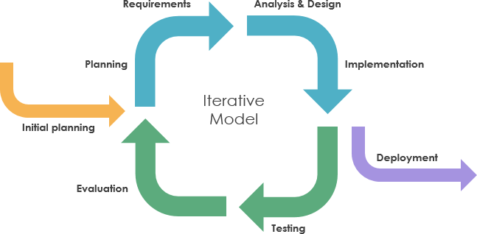
The proposed system will follow an iterative model for the development of the system which typically involves data collection, training ML model, evaluating, improving, and repeating the process until the model is performing well.
Fig. 1. Iterative Model
[Source: medium.com]

Slide 22
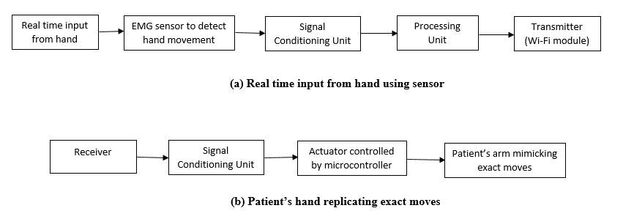
Methodology
Fig. 2. Block Diagram of a Proposed System

Slide 23
Input
The input to the system will be the hand movements in real time given using surface EMG sensor

Slide 24
2. Algorithms
k-NN (k- Nearest Neighbour)
It is supervised Machine Learning algorithm used for classification
The k-NN algorithm compares a new data entry with the given dataset and based on its similarity on a given region (k) of neighbours, it assigns the label to the new data
k-NN calculates the distance between new data and existing data in the dataset and find its k nearest neighbour

Slide 25
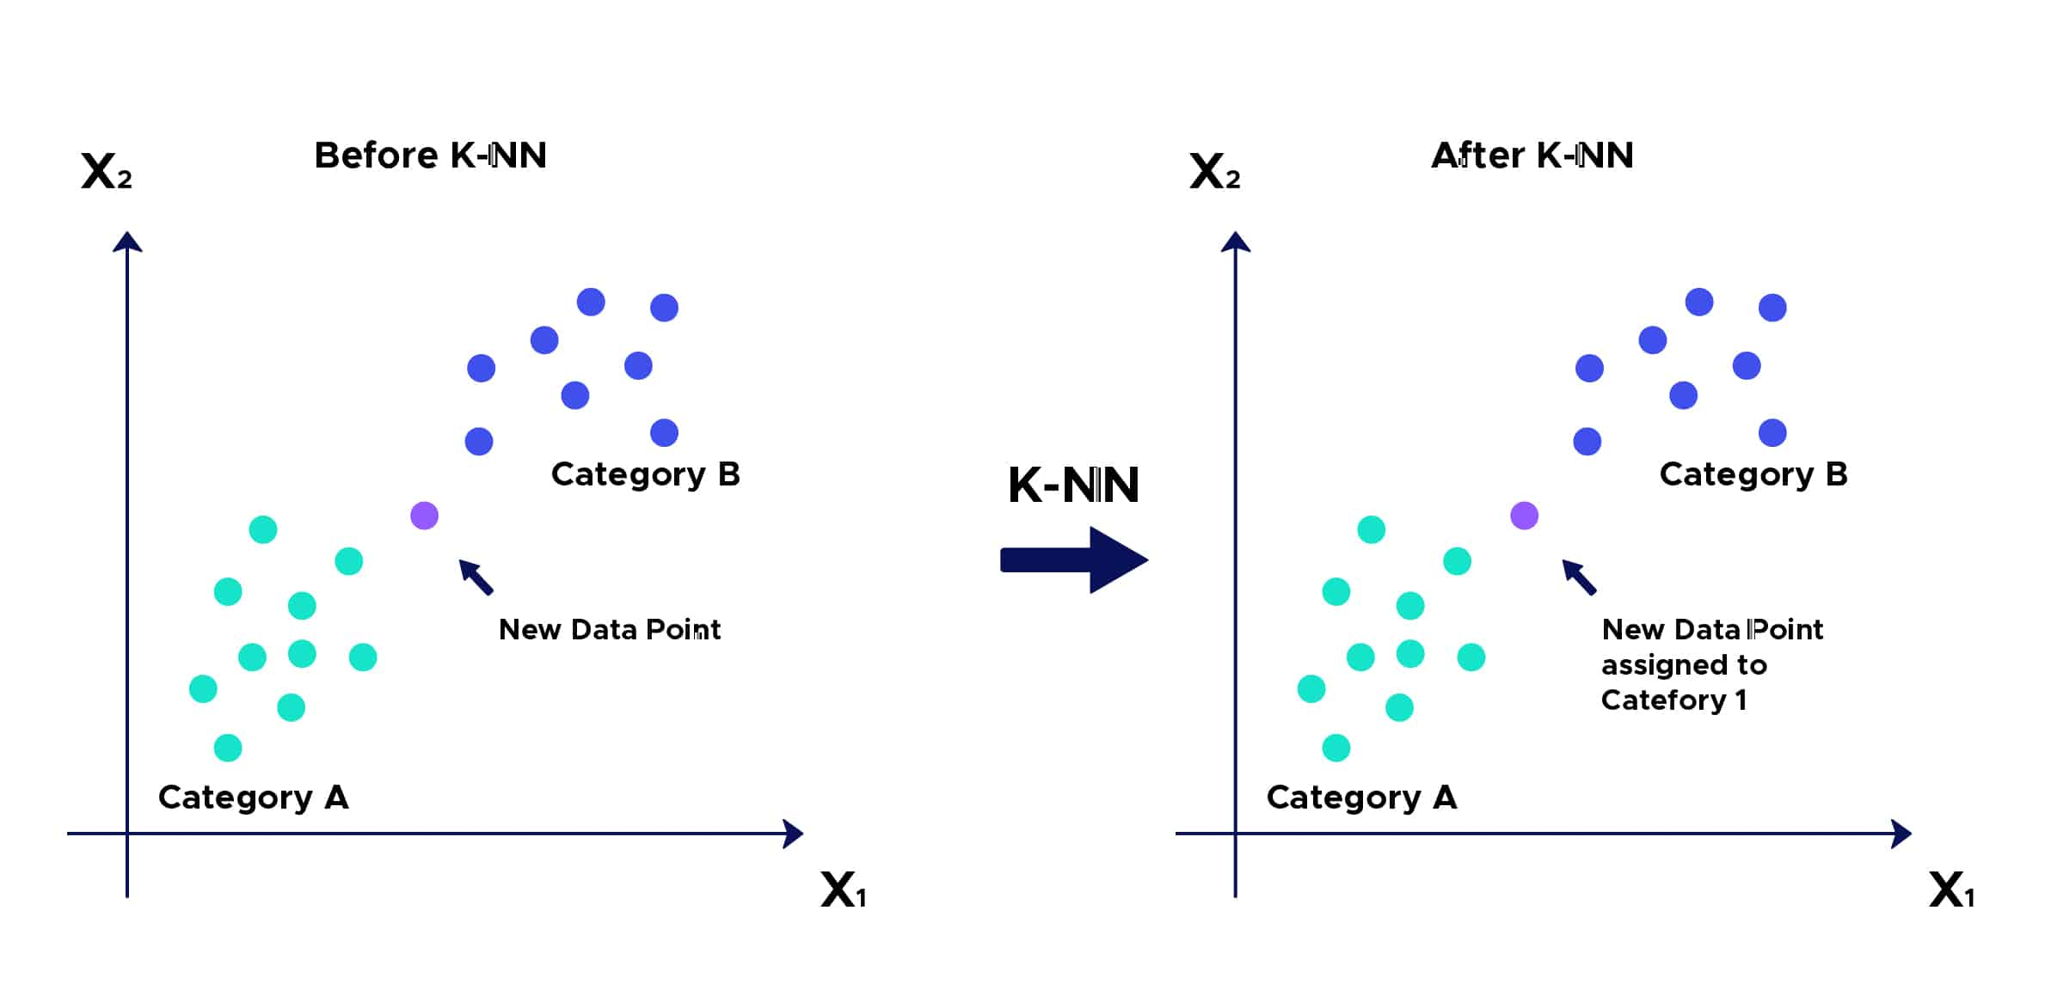
Fig. 3. K-NN Algorithm for Classification
[Source: DataScientest.com]

Slide 26
Alternative Technique
Support Vector Machine (SVM)
SVM is a supervised Machine Learning technique
SVM classifies data by finding the optimal boundary that separates classes in an N-dimensional space
The hyperplane is chosen in a way that it can have a maximum distance from the closest datapoint in a dataset
SVM algorithm can handle both linear and non-linear data

Slide 27
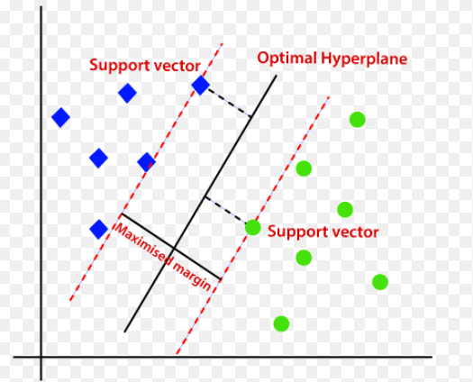
Fig. 4. Support Vector Machine
[Source: Javatpoint.com]

Slide 28
ESP-NOW Protocol
ESP-NOW is a wireless communication protocol based on data link layer
Designed by Espressif
It is used to transfer data packets between two ESP devices
The protocol allows paired devices to communicate directly without any Wi-Fi connection or third party device
ESP-NOW uses MAC address of the device to which it wants to send data packets

Slide 29
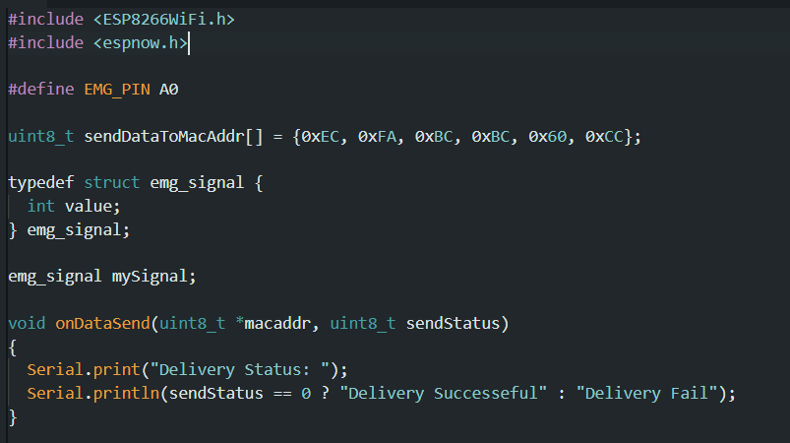
Experimental Work
Read EMG values and sending to other ESP8266

Slide 30
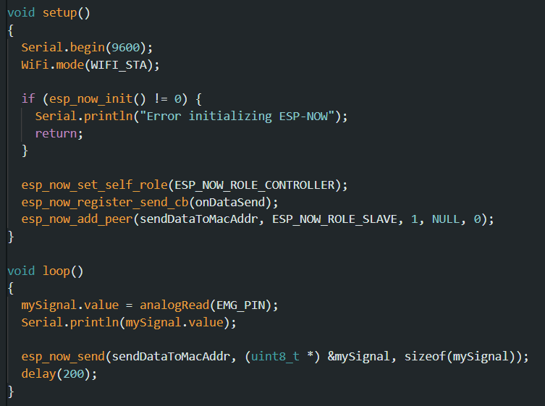

Slide 31
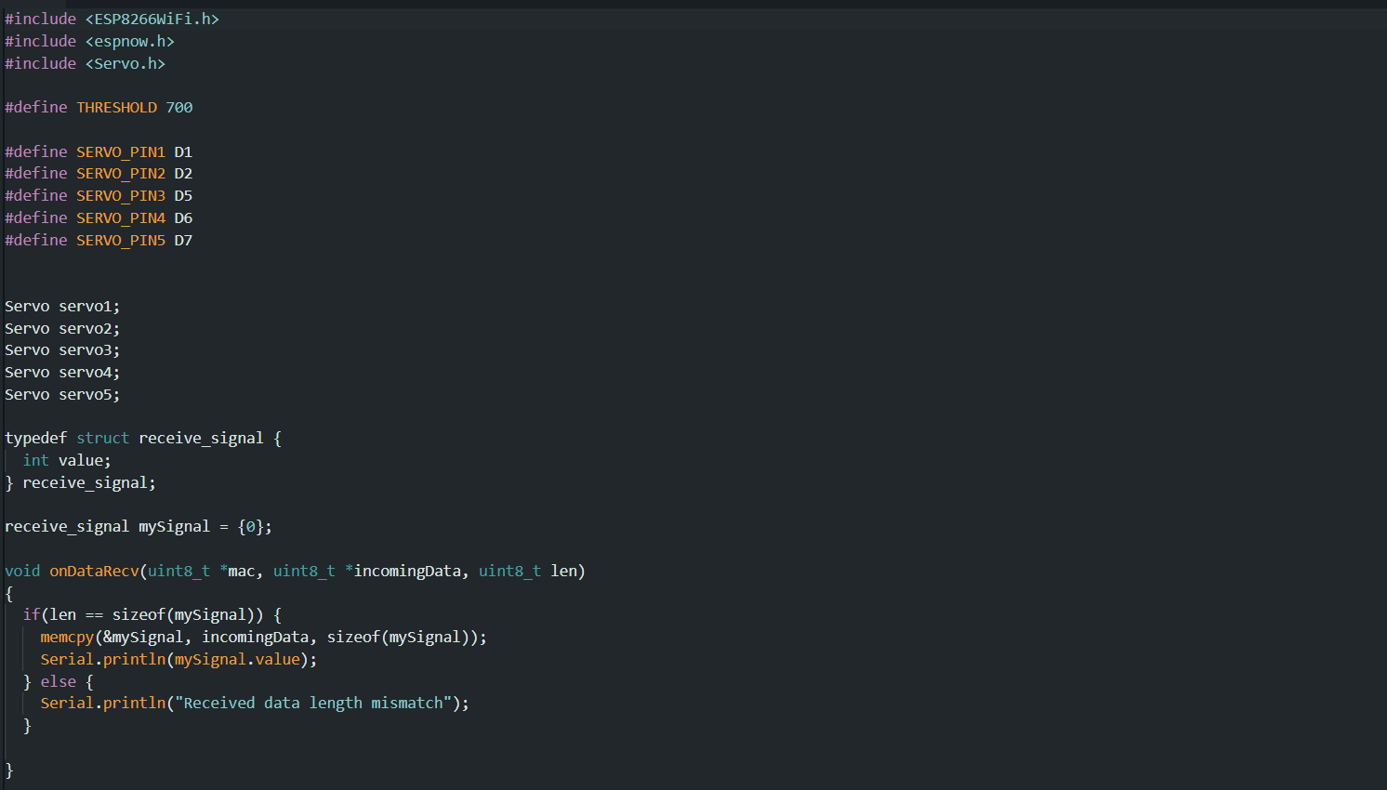
Rotating servo motor on other ESP8266 by reading EMG data

Slide 32
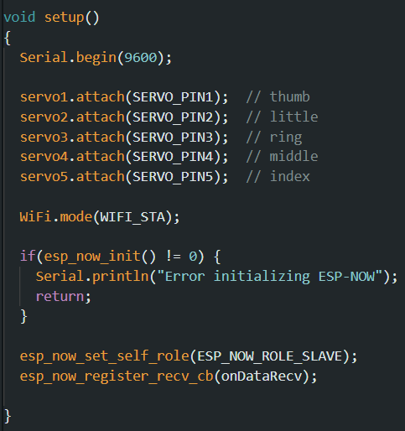
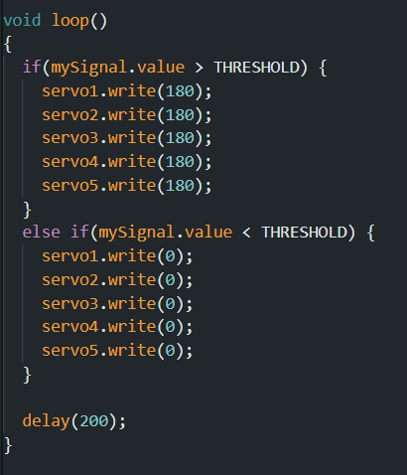

Slide 33
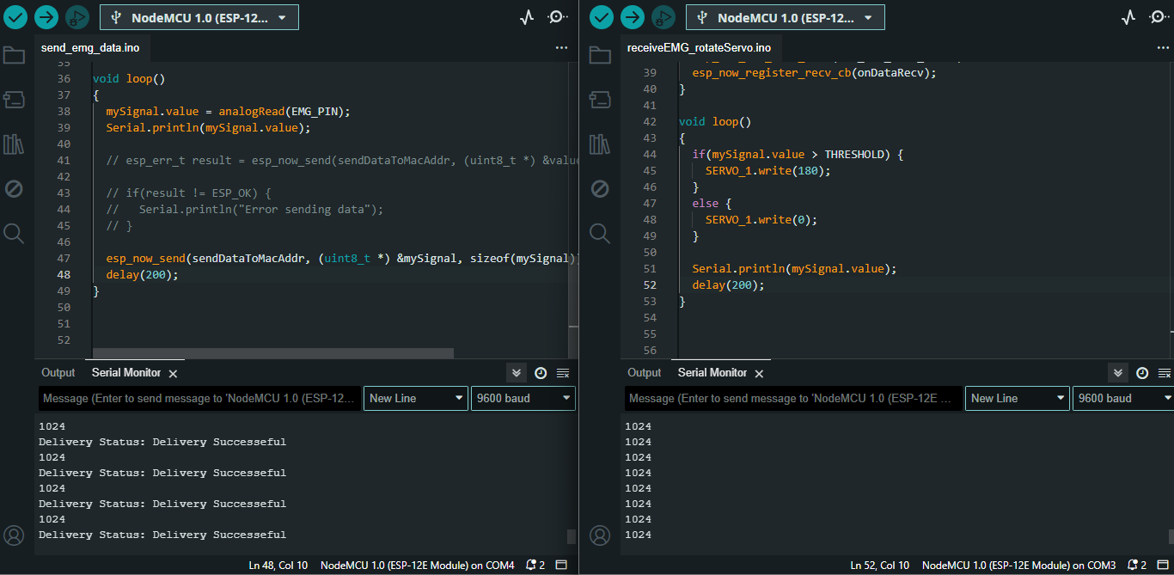
Output

Slide 34
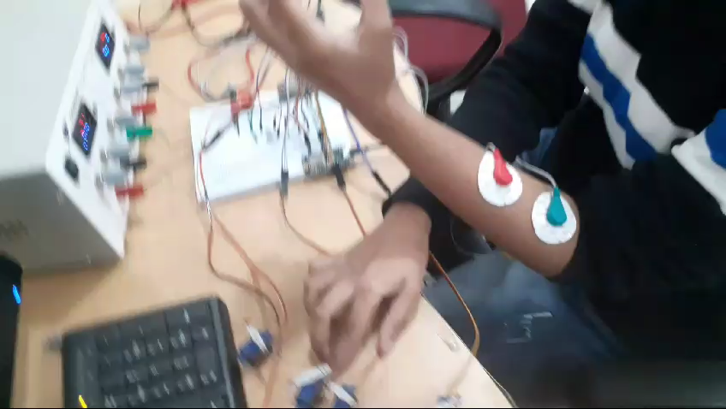
Output

Slide 35
References
[1] Francesco Di Nardo, Antonio Nocera, Alessandro Cucchiarelli, Sandro Fioretti and Christian Morbidoni, “Machine Learning for Detection of Muscular Activity from Surface EMG Signals”, Sensors, 22(3393), pp. 1-17, April 2022
[2] Ankita L. Dharmik, S. K. Atre, S. J. Sharma, “Design of an Exoskeleton for Hand Rehabilitation”, IEEE Conference and Interdisciplinary Approach in Technology and Management for Social Innovation (IATMS), 1(1), pp. 1-4, 2022
[3] Mailyn Calderon-Diaz, Rony Silvestre Aguirre, Juan P. Vasconez, Roberto Yanez, Matias Roby, Marvin Querales, Rodrigo Salas, “Explainable Machine Learning Techniques to Predict Muscle Injuries in Professional Soccer Players through Biomechanical Analysis”, Sensors, 24(119), pp. 1-13, 2024;
[4] Ching Yee YONG and Terence Tien Lok SIA, “I Want to Control Your Move: Human-Human Interface (HHI) Neuromuscular Electrical Stimulator (NMES)”, Conference of Electronics, Communication and Networks (CECNet), 1(1), pp. 724-730, 2022

Slide 36
References
[5] Nestor J. Jarque-Bou, Joaquin L. Sanche-Bau, Margarita Vergara, “A Systematic Review of EMG Applications for the Characterization of Forearm and Hand Muscle Activity during Activities of Daily Living: Results, Challenges, and Open Issues”, Sensors, 21(3035), pp. 1-26, 2021
[6] Yassine Bouteraa, Ismail Ben Abdallah, Khalil Boukthir, “A New Wrist-forearm Rehabilitation Protocol Integrating Human Biomechanics and SVM-Based Machine Learning for Muscle Fatigue Estimation”, Bioengineering, 10(219), pp. 1-22, 2023
[7] Md. Latifur Rahman, Md. Jahin Alam, Nayeed Rashid, Lamiya Hassan Tithy, Alfaj Uddin Ahmed, and M Tarik Arafat, “IoT Based Cost Efficient Muscle Stimulator for Biomedical Application”, 2020 IEEE Region 10 Symposium (TENSYMP), 1(1), pp. 1-5, 2020
[8] Nat Wannawas and Aldo Faisal, “Towards AI-controlled FES-restoration of arm movements: Controlling for progressive muscular fatigue with Gaussian state-space models”, 11th International IEEE/EMBS Conference on Neural Engineering (NER), 1(1), pp. 1-4, 2023

Slide 37
References
[9] Dr. G. Sophia Reena, “Posture Guardian With Smart Muscle Strain Detection And Correction Using TINYML”, Journal of Propulsion Technology, 44(4), pp. 5187-5194, 2023
[10] DERVİŞ PAŞA, “Development of Wireless Microcontroller Based Functional Electronic Stimulation Device for Drop Foot Correction”, Near East University, Nicosia, pp. 1-87, 2014
[11] Xiaoshi Chen, Li Gong, Lirong Zheng, and Zhuo Zou, “Soft Exoskeleton Glove for Hand Assistance Based on Human-Machine Interaction and Machine Learning”, IEEE International Conference on Human-Machine Systems (ICHMS), Rome, Italy, 1(1), 2020
[12] Xiaoshi Chen, Li Gong, Liang Wei, Shih-Ching Yeh, and Li Da Xu, “A Wearable Hand Rehabilitation System with Soft Glove”, IEEE Transactions on Industrial Information, 17(2), pp. 943-952, 2020

Slide 38
References
[13] Alireza Mohammadi, Jim Lavranos, Peter Choong, and Denny Oetomo, “Flexo-glove: A 3D Printed Soft Exoskeleton Robotic Glove for Impaired Hand Rehabilitation and Assistance”, 40th Annual International Conference of the IEEE Engineering in Medicine and Biology Society (EMBC), Honolulu, USA, pp. 2120-2123, 2018
[14] Waqas Ahmed, Muhammad Kashif Sattar, Wajeeha Shahnawaz, Umair Saeed, Shahbaz Mehmood Khan, and Neha Amon Khan, “Wearable Hand-Rehabilitation System with Soft Gloves for Patient with Face Paralysis and Disability”, Engineering Proceedings, 12(56), pp. 1-5, 2021
[15] Xuanyi Zhou, Hoa Fu, Baoqing Shentu, Weidong Wang, Shibo Cai, and Guanjan Bao, “Design and Control of a Tendon-Driven Robotic Finger Based on Frasping Task Analysis”, Biomimetics, 9(370), pp. 1-17, 2024

Slide 39
Thank You

